Slide 1
BITS Pilani
Dr.Aruna Malapati
Asst Professor
Department of CSIS

Slide 2
Data Types

Slide 3
Today’s Agenda
Motivation to learn data types
Data Types
Primitive Data Types
  Integer, Floats, Complex, Decimal, Char, Strings
User-defined ordinal types

Slide 4
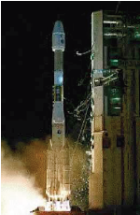
Motivation
What happens if you assign a 64-bit integer to a 16-bit integer?
Ariane 5 Crash, June 1996
Expensive programming mistake
Can this be avoided?
“Well typed programs don’t ‘go wrong’.”
(Robin Milner, Turing-Award 1991)

Slide 5

Does the computer
know about data types?
No.

Slide 6
Data Types
Programming languages need a variety of data types in order to better model/match the world
  more data types make programming easier but too many data types might be confusing
    which data types are most common?
    which data types are necessary?
    which data types are uncommon yet useful?
  how are data types implemented in the various languages?
Almost all programming languages provide a set of primitive data types
  primitive data types are those not defined in terms of other data types
  some primitive data types are implemented directly in hardware (integers, floating point, etc) while others require some non-hardware support for their implementation such as arrays

Slide 7
Language Support of Data Types
Historically, we see the following:
  FORTRAN only had numeric types and arrays
  COBOL introduced advanced record structures, character strings and decimal
  Lisp had built-in linked lists
  PL/I was the first language to offer a wide range of types but did not allow for tailor-made types
  ALGOL 68 took a different approach by offering few types but these types were combinable into many advanced types
    strings = arrays + chars
    lists, trees, queues, stacks, graphs, sets = records + pointers or arrays
Most languages since ALGOL have adopted ALGOL’s approach – few basic types that can are used to define a greater variety

Slide 8
Primitive Data Types
Types supported directly in hardware of the machine
  Integer: byte, short, int, long, signed, unsigned
  Floating Point: single and double precision
    stored in 3 parts: sign bit, exponent, mantissa
  Complex: numbers that contain an imaginary part
    available in languages like Common Lisp, FORTRAN and Python
  Decimal: BCD (2 decimal digits per byte)
    for business processing whereby numbers (dollars and cents) are stored as 1 digit per ½ byte instead of using an int format
    popularized in COBOL, also used in PL/I and C#
  Boolean: 1-bit value (usually referenced as true or false)
    available in C++, Java, Pascal, Ada, Lisp, but not C
    in Lisp, the values are T or NIL
    for hardware convenience, these are often stored in 1 byte or 1 word!
  Character: ASCII or Unicode
    IBM mainframes use a different code called EBCDIC
    Java, Javascript C# support Unicode

Slide 9
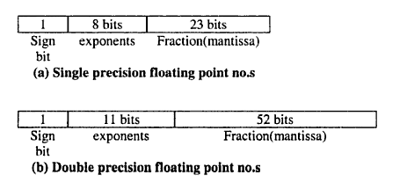
Primitive Data Types: Floating Point
•Model real numbers, but only as approximations
•Languages for scientific use support at least two floating-point types (e.g., float and double; sometimes more
•Usually exactly like the hardware, but not always
•IEEE Floating-Point Standard 754

Slide 10
Character Strings
Should a string be a primitive type or defined as an array of chars?
  few languages offer them as primitives (SNOBOL does)
  in most languages, they are arrays of chars (Pascal, Ada, C/C++)
  Java/C# offer them as objects
Design issues:
  should strings have static or dynamic length?
  can they be accessed using indices (like arrays)?
    this is true if the string is treated as an array
  what operations should be available on strings?
    assignment, <, =, >, concat, substring
      available in Pascal/Ada only if declared as packed arrays
      available through libraries in C/C++ and through built-in objects in Java/C#
Character string types could be supported directly in hardware, but in most cases, software implements them as arrays of chars
  so the questions are:
    how are the various operations implemented
      as library routines/class methods or directly in the language?
    how is string length handled?

Slide 11
String length options
Static: The length can be static and set when the str is created. Ex COBOL, Java’s String class
Limited Dynamic Length: C and C++
      In these languages, a special character is used to indicate the end of a string’s characters, rather than maintaining the length
Dynamic (no maximum): SNOBOL4, Perl, JavaScript
Ada supports all three string length options

Slide 12
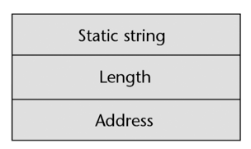
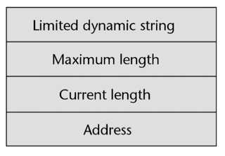
Implementation of character string types
Static length: compile-time descriptor
Limited dynamic length: may need a run-time descriptor for length (but not in C and C++)
Dynamic length: need run-time descriptor; allocation/de-allocation is the biggest implementation problem
Notes:
static length strings, in which the length of strings is fixed – only works well for immutable strings (that can’t be modified) – examples: strings in Java and C# – are easy to implement, but inflexible – each string operation must create and return a new string (inefficient)
• limited dynamic length strings, in which the maximum length of strings is fixed (but shorter strings can be stored) – examples: strings in C (as arrays of characters) – require the programmer to be careful about string lengths – often use an EOS character such as ’\0’ to mark the end of meaningful content in the string – are more efficient (time) and easy to implement
• dynamic length strings – examples: strings in JavaScript and Perl – are very flexible and easy to use – require resizing at runtime (expensive in time and memory)

Slide 13
User-defined ordinal types
An ordinal type is any type whose values can easily be mapped to the set of positive integers.
Examples of primitive ordinal types in Java
      integer
      char
      boolean
There are two user-defined ordinal types: enumeration and subrange.

Slide 14
Enumeration types
All possible values, which are named constants, are provided in the definition
C# example:
enum days {mon, tue, wed, thu, fri, sat, sun};
C++ example:
enum colors {red, blue, green, yellow, black};
colors myColor = blue, yourColor = red;
myColor++ //possible
myColor = 4; //not possible
Notes:
An enumeration type is a type in which all possible values are listed in the declaration.
Example (C++): enum stoplight {red, yellow, green};
The values are called enumeration constants.
A program can then:
• declare variables of type stoplight
• assign any of the constants red, green or yellow to such a variable
• compare variables of type stoplight to these constants in conditions
• . . . Using such a type makes programs easier to understand than if integers are used to encode possible values. Design issues with enumeration types:
• can enumeration constants and variables of enumeration types be treated as integers? (yes in C++, no in Ada, C#)
• can the same enumeration constant be a member of multiple enumeration types (yes in Ada, no in C++)
Enumeration types are included in C, C++, C# and Ada (but not in Java 1.4 and earlier).

Slide 15
Subrange Types
A contiguous subsequence of an ordinal type.
Example: 12..18 is a subrange of integer type.
Ada’s design:
type Days = (mon, tue, wed, thu, fri, sat, sun);
Weekdays = mon..fri;
Day1: Days;
Day2: Weekday;
Day2 := Day1; //the assignment is legal unless the value of Day1 is Sat or Sun
Notes:
Subrange types were introduced by Pascal and are included in Ada.

Slide 16
Array types
An array is a homogeneous aggregate of data elements in which an individual element is identified by its position in the aggregate, relative to the first element.
The individual data elements of an array are of the same type.
References to individual array elements are specified using subscript expressions.

Slide 17
Design issues
The primary design issues specific to arrays are the following:
What types are legal for subscripts ?
When are subscript ranges bound ?
When does array allocation take place ?
How many subscripts are allowed ?
Can arrays be initialized when they have their storage allocated ?
What kind of slices are allowed, if any ?

Slide 18
Arrays and indices
Indexing (or subscripting) is a mapping from indices to elements
array_name (index_value_list) → an element
Index Syntax
      FORTRAN, PL/I, Ada use parentheses
      Ada explicitly uses parentheses to show uniformity between array references and function calls because both are mappings
      Most other languages use brackets

Slide 19
Subscript Bindings and Array Categories
In some languages the lower bound of the subscript range is implicit (e.g., fixed to 0 in C).
Five categories of arrays based on the binding to subscript value ranges, and the binding to storage:
Static array
Fixed stack-dynamic array
Stack-dynamic array
Fixed heap‐dynamic
Heap-dynamic array
Notes:
Static: subscript ranges are statically bound and storage allocation is static (before run‐ time)
o Advantage: efficiency (no dynamic allocation)
o Example: In C and C++ arrays that include the static modifier are static
static int myarray[3] = {2, 3, 4};
Fixed stack‐dynamic: subscript ranges are statically bound, but the allocation is done at declaration time
o Advantage: space efficiency
o Example: arrays without static modifier are fixed stack‐dynamic
int array[3] = {2, 3, 4};
Stack‐dynamic: subscript ranges are dynamically bound and the storage allocation is dynamic (done at run‐ time)
o Advantage: flexibility (the size of an array need not be known until the array is to be used)
o Example: In Ada, you can use stack‐dynamic arrays as
Get(List_Len);
declare List: array (1..List_Len) of Integer
begin
...
end;

Slide 20
Subscript bindings and Array categories
Static: subscript ranges are statically bound and storage allocation is static (before run-time)
Advantage: efficiency (no dynamic allocation)
Fixed stack-dynamic: subscript ranges are statically bound, but the allocation is done at declaration time
Advantage: space efficiency
Stack-dynamic: subscript ranges are dynamically bound and the storage allocation is dynamic (done at run-time)
Advantage: flexibility (the size of an array need not be known until the array is to be used)

Slide 21
Subscript bindings and Array categories
Fixed heap-dynamic: similar to fixed stack-dynamic: storage binding is dynamic but fixed after allocation (i.e., binding is done when requested and storage is allocated from heap, not stack)
Advantage: flexibility (the array’s size always fits the problem)
Heap-dynamic: binding of subscript ranges and storage allocation is dynamic and can change any number of times
      Advantage: flexibility (arrays can grow or shrink during program execution)
Notes:
Fixed heap‐dynamic: similar to fixed stack‐ dynamic: storage binding is dynamic but fixed after allocation (i.e., binding is done when requested & storage is allocated from heap, not stack)
o Example: In C/C++, using malloc/free to allocate/deallocate memory from the heap o Java has fixed heap dynamic arrays
o C# includes a second array class ArrayList that provides fixed heap‐dynamic
Heap‐dynamic: binding of subscript ranges and storage allocation is dynamic and can change any number of times
o Advantage: flexibility (arrays can grow or shrink during program execution)
o Examples: Perl, JavaScript, Python, and Ruby support heap‐dynamic arrays
o Perl: @states = (“Assam",“Goa",“Telangana");
o Python: a = [1.25, 233, 3.141519, 0, ‐1]

Slide 22
Subscript bindings and Array categories
C and C++ arrays that include static modifier are static
C and C++ arrays without static modifier are fixed stack-dynamic
C and C++ provide fixed heap-dynamic arrays
C# includes a second array class ArrayList that provides fixed heap-dynamic

Slide 23
Array Initialization and Operations
Initialization
  FORTRAN 77 offers optional initialization at allocation time (load time)
  C/C++/Java offer optional initialization that can also dictate array size and through initializations, you can create jagged arrays
  in Ada, specific elements can be specified rather than initializing the entire array
  for Pascal, Modula-2, no array initializations
  most languages permit only initialization and access to a single element

Slide 24
Assignment
  Ada, Pascal allow entire array assignment if the arrays are of the same type/size
    Ada also has array concatenation
  in C/C++/Java, assignment is copying a pointer, not duplicating the array
  FORTRAN 95 includes a variety of array operations
    such as +, relational operations (comparisons), matrix multiplication and transpose, etc (all through library routines)
  APL includes a collection of vector and matrix operations

Slide 25
Array Operations
Assignment (Most langauges)
Concatenation
Element membership (in Python).
Comparison for equality or inequality
Notes:
Pyton (in,is,==)
Ruby (== )
Fortran 95+ (+) The assignment, arithmetic, relational, and logical operators are all overloaded for arrays of any size or shape
F# includes many array operators in its Array module. Among these are Array.append, Array.copy, and Array.length.
In APL, the four basic arithmetic operations A+B is a valid expression, whether A and B are scalar variables, vectors, or matrices.
APL includes a collection of unary operators for vectors and matrices, some of which are as follows (where V is a vector and M is a matrix):
ΦV reverses the elements of V
ΦM reverses the columns of M
θM reverses the rows of M
M transposes M (its rows become its columns and vice versa)
One of these is the inner product operator, which is specified with a period (.). It takes two operands, which are binary operators. For example,
+.×
is a new operator that takes two arguments, either vectors or matrices. It first multiplies the corresponding elements of two arguments, and then it sums the results.
For example, if A and B are vectors,
A × B
is the mathematical inner product of A and B (a vector of the products of the corresponding elements of A and B).
The statement
A +.× B
is the sum of the inner product of A and B. If A and B are matrices, this expression
specifies the matrix multiplication of A and B.

Slide 26
Slices
Definable substructure of an array
  e.g., a row of a 2 D array or a plane of a 3-D array
Perl: @a = (2, 5, 7, 3, 8, 6, 4);
@a[0..2]; # (2, 5, 7)
@a[2..4]; # (7, 3, 8)
@a[-3..-1]; # (8, 6, 4)
Python nums = [1, 3, 5, 7, 8, 13, 20]
nums[:3] #equals [1, 3, 5], from index 0 (inclusive) until index 3 (exclusive)

Slide 27
Rectangular and Jagged Arrays
A rectangular array is a multi-dimensioned array in which all of the rows have the same number of elements and all columns have the same number of elements
A jagged matrix has rows with varying number of elements
      Possible when multi-dimensioned arrays actually appear as arrays of arrays
C# and Java support jagged arrays
Notes:
A jagged array (or ragged array) is a multidimensional array in which the length of rows (columns, etc.) need not all be the same.
For example, a Java array constructed as follows:
int [][] rArray = new int[3][];
rArray[0] = new int[3];
rArray[1] = new int[7];
rArray[2] = new int[5];
is a jagged array.
Jagged arrays are possible when multidimensional arrays are implemented as arrays of arrays.

Slide 28
Implementation of Array types
Implementing arrays requires considerably more compile-time effort than does implementing primitive types.
A single-dimensioned array is implemented as a list of adjacent memory cells.
A[i] = (base-low*w) + i*w
Notes:
Let w = the size of the basetype
base = the base address
The address of A[k] is base + (k - low) ∗ w
This is usually expressed as: (base - low ∗ w) + k ∗ w
In C, C++ and Java, low ≡ 0, so this formula becomes base + k ∗ w

Slide 29
Example
int a[200-205]={10,20,30,40,50,60};
The base address is 1000
Then A[204] can be computed using
A[i] = (base-low*w) + i*w
A[204] = (1000-200*4) + 204*4
= 1000-800+ 816
= 1016

Slide 30
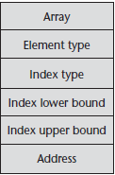
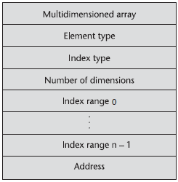
Implementation of Array types
Compile-time descriptor for single-dimensioned arrays.
Row major order : used in most languages
Column major order: used in Fortran

Slide 31
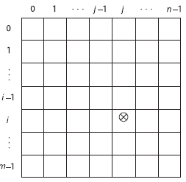
Implementation of Array types
The location of the [i,j] element in a matrix
location(a[i,j]) = i*w₁+j*w₂+(base-low₁*w₁-low₂*w₂)

Slide 32
Associative Arrays
An associative array is an unordered collection of data elements that are indexed by an equal number of values called keys.
        User-defined keys must be stored
Design issues
  What is the form of references to elements?
  Is the size dynamic or static?
%ages = ("Michael Caine", 39, "Dirty Den", 34, "Angie", 27, "Willy", "21 in dog years",
"The Queen Mother", 108);
Now we can find the age of people with the following expressions
$ages{"Michael Caine"}; # Returns 39
$ages{"Dirty Den"}; # Returns 34
$ages{"Angie"}; # Returns 27
$ages{"Willy"}; # Returns "21 in dog years

Slide 33
Tuple Types
A tuple is a data type that is similar to a record, except that the elements are not named.
Python includes an immutable tuple type.
Example myTuple = (3, 5.8, 'apple')
One use of tuples is when an array must be write protected

Slide 34
LIST Types
LISP
(CONS 'A '(B C))
(CAR '(A B C))
(CDR '(A B C))
Python list comprehensions.
[x * x for x in range(12) if x % 3 == 0]
Range function creates the following array
[0, 1, 2, 3, 4, 5, 6, 7, 8, 9,10, 11, 12]
list comprehensions filters the following elements
[0, 9, 36, 81]

Slide 35
Record Types
A record is a possibly heterogeneous aggregate of data elements in which the individual elements are identified by names
In C, C++, and C#, records are supported with the struct data type.
The fundamental difference between a record and an array is that record elements, or fields, are not referenced by indices.
Most languages use dot notation for field references; for example:
Employee_Record.Employee_Name.Middle

Slide 36
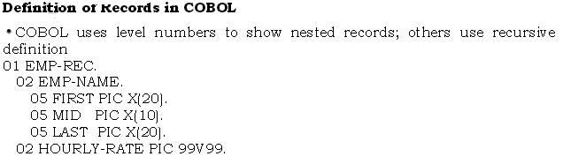
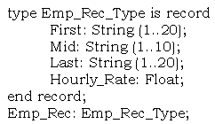
Record Types
Operations on Records
Assignment is very common if the types are identical
Ada allows record comparison.
Ada records can be initialized with aggregate literals
COBOL provides MOVE CORRESPONDING
– Copies a field of the source record to the
corresponding field in the target record
– Records need not be identical in structure
Definition of records in Ada
• COBOL layouts have levels, from level 01 to level 49.
• Level 01 is a special case, and is reserved for the record level; the 01 level is the name of the record

Slide 37
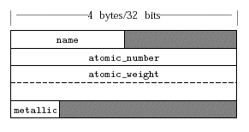
Records Memory Layout
Basic layout in 32-bit machines
  There may be holes in the allocation of memory

Slide 38
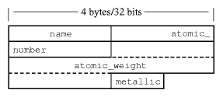
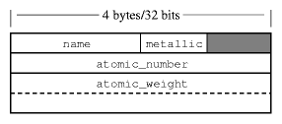
Records Memory Layout
Packed layout
Rearranging record field

Slide 39
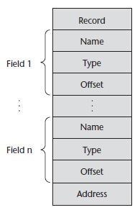
A compile-time descriptor for a record

Slide 40
Evaluation and Comparison to Arrays
Arrays are used when all the data values have the same type and/or are processed in the same way.
Records are used when collection of data values is heterogeneous and the different fields are not processed in the same way.
Access to array elements is much slower than access to record fields, because subscripts are dynamic (field names are static)

Slide 41
Union Types
A union is a type whose variables are allowed to store different type values at different times during execution.
Design issues
  Should type check be required?
  Should unions be embedded in records?
Discriminated Vs Free Unions
  Fortorn, C, C++ provide constructs in which there is no language support for type checking; the union in these languages is called free union.
  Type check of unions require each union include a type indicator called Discriminant(Supported in Ada).

Slide 42
Union Types
The C union type creates a large hole in static typing (large even for C with its relatively weak type system)
union { int a; float p} u;
u.a = 1;
x += u.p;
• Union types were developed because memory was a very scarce resource
• In the union type, memory is shared between the members of the union
– But only one interpretation is correct depending on previous assignment

Slide 43
Discriminated vs. Free Unions
Fortran, C, and C++ provide union constructs in which there is no language support for type checking; the union in these languages is called free union
Type checking of unions require that each union include a type indicator called a discriminant
Supported by Ada, Pascal

Slide 44
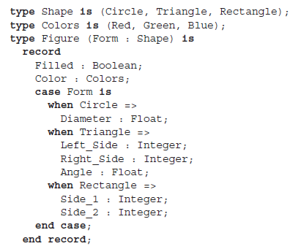
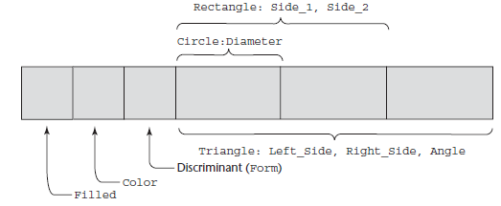
Figure_1 : Figure;
Figure_2 : Figure(Form => Triangle);
Figure_1 := (Filled => True, Color => Blue,
Form => Rectangle, Side_1 => 12, Side_2 => 3);

Slide 45
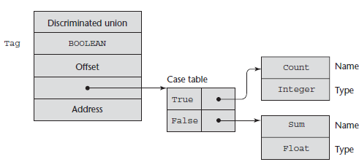
Descriptor for a discriminated union
type Node (Tag : Boolean) is
record
case Tag is
when True => Count : Integer;
when False => Sum : Float;
end case;
end record;

Slide 46
Pointer and Reference Types
A pointer type variable has a range of values that consists of memory addresses and a special value, null.
Provide the power of indirect addressing.
Provide a way to manage dynamic memory.
A pointer can be used to access a location in the area where storage is dynamically created (usually called a heap).

Slide 47
Design Issues
What are the scope and lifetime of a pointer variable?
What is the lifetime of a heap -dynamic variable?
Are the pointers restricted to the type of value they point to?
Are pointers used dynamic storage management

Slide 48
Pointer Operations
Two fundamental operations: assignment and dereferencing.
Assignment is used to set a pointer variable’s value to some useful address.
Dereferencing yields the value stored at the location represented by the pointer’s value.
Dereferencing can be explicit or implicit.

Slide 49
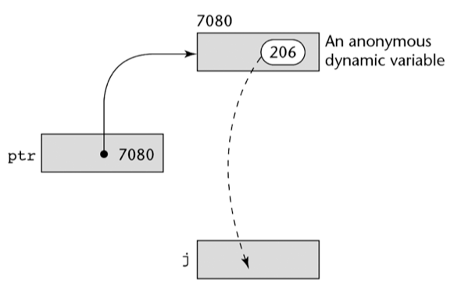
Pointer Assignment Illustrated
C++ uses an explicit operation via *:
j = *ptr
sets j to the value located at ptr

Slide 50
Pointers in C and C++
Extremely flexible but must be used with care.
Pointers can point at any variable regardless of when or where it was allocated.
Used for dynamic storage management and addressing.
Pointer arithmetic is possible.
Explicit dereferencing and address-of operators.

Slide 51
Pointers in C and C++
The asterisk (*) denotes the dereferencing operation.
The ampersand (&) denotes the operator for producing the address of a variable.
int *ptr;
int count, init;
……
ptr = &init; //address
count = *ptr; //value

Slide 52
Problems with pointers
Dangling Pointers
  int *p1, *p2;
  p1 = new int;
  p2 = p1;
  ...
  delete(p1);
Lost Heap-Dynamic Variables (memory Leak)
P1
Heap Variable
Garbage
New Heap Variable

Slide 53
Reference Types
Reference types are restricted forms of pointer types.
They have the same representation as pointers, but do not support the full range of pointer operations, and so are usually safer to use than pointers.
In Java, references:
  can contain null
  are allocated using new
  can only refer to instances of classes. In fact, a variable of a class type is always a reference.
  are implicitly dereferenced by the . operator

Slide 54
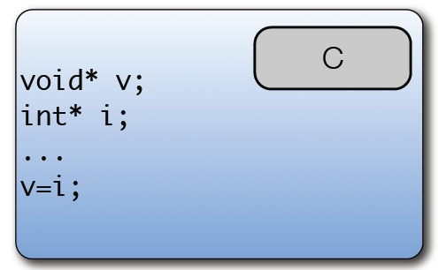
Generic Reference Types
• It is often useful to have a generic reference type that
can hold any type of object
• In Java this is Object
• In C and C++ this is void *

Slide 55
Summary
Data types determine language style and use (heart of a language along with control structures).
Primitive types: numeric, character, boolean.
User-defined: enumeration & subrange types are convenient and make programs more readable.
Arrays are part of most programming languages.
Records are now included in most languages.
Safe discriminated unions are difficult to design.
Pointers have inherent dangers: dangling pointers and garbage collection issues.
Pointers are costly to implement if they are used for dynamic storage management and if steps are taken to avoid dangling pointers.

